Slide 1
QEEG Diagnostics and
Bio-Neurofeedback
Devon Greco
Founder, Narbis.com
Devon, Pennsylvania
dgreco@narbis.com

Slide 2
Intro
1 2 3 4 5 6 7 8 9 10

Slide 3
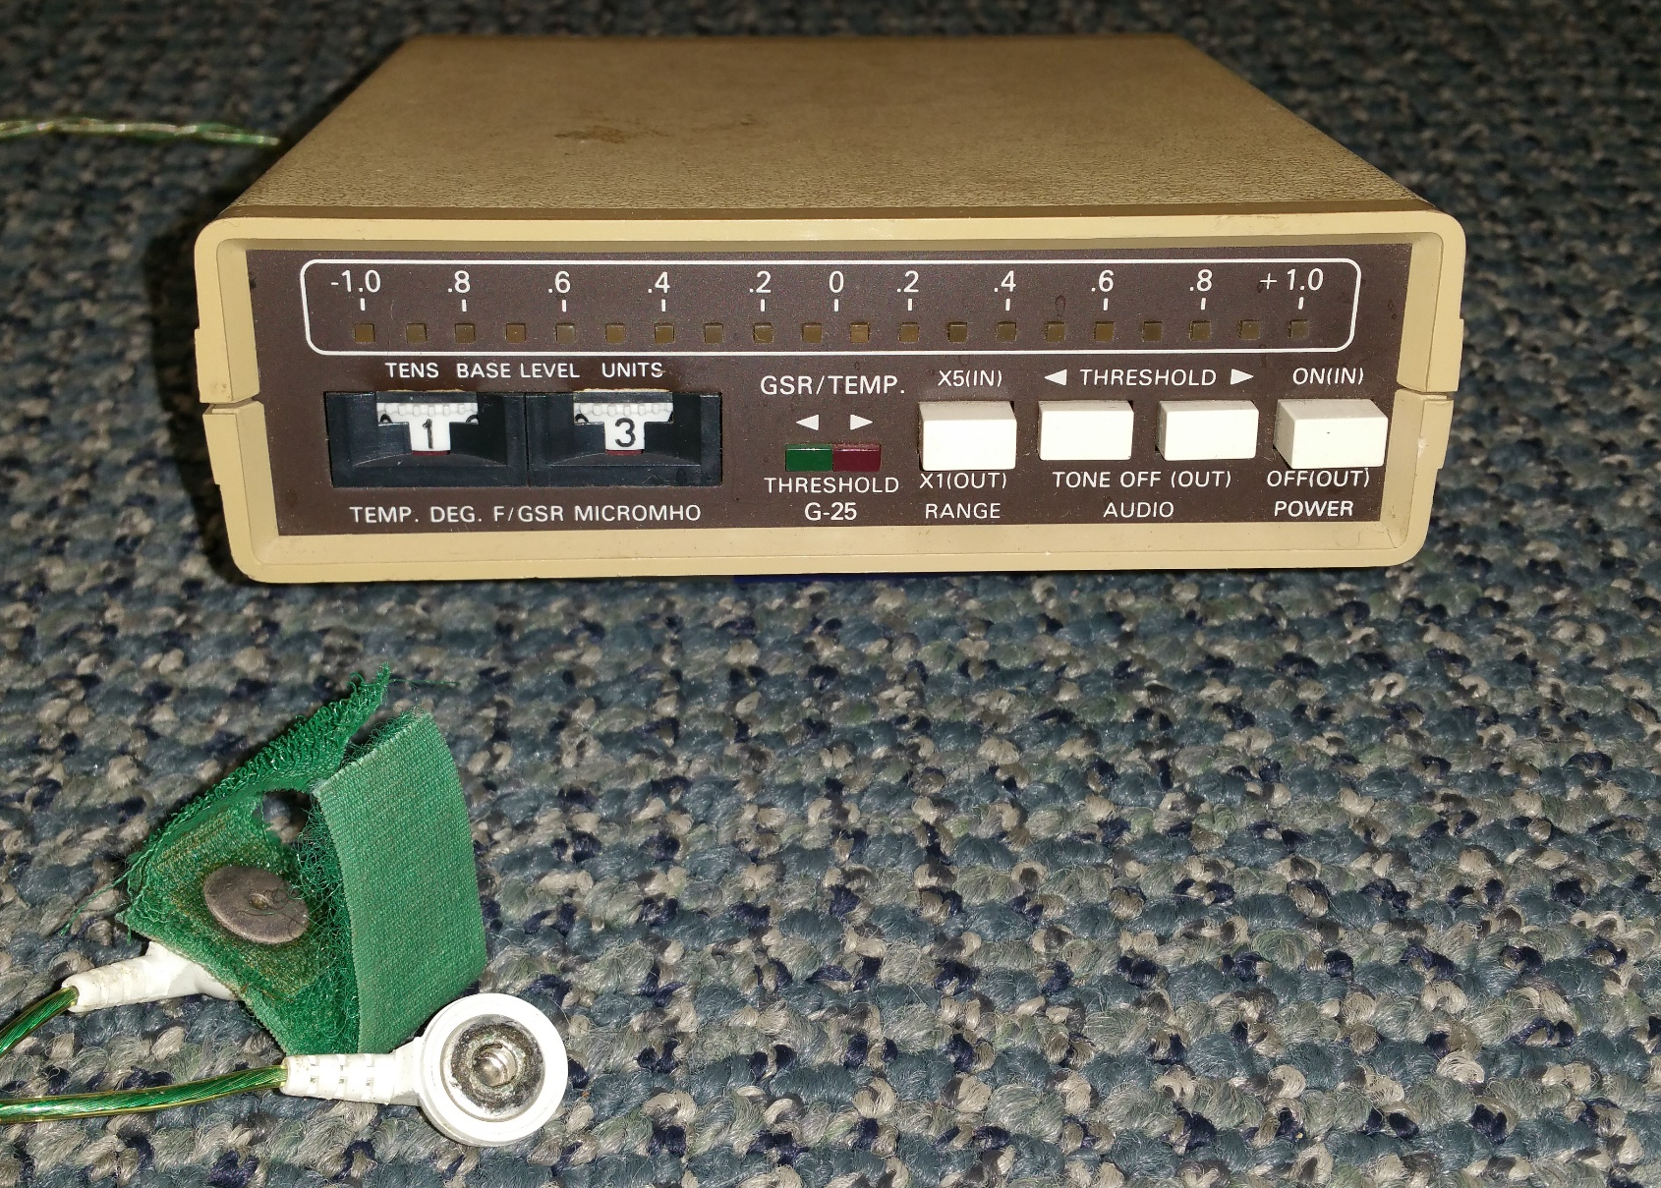
Notes:
Question: show of hands how many have used biofeedback or neurofeedback?
Story: Sittings on floor in Dad’s clinic, control speaker sound with breath
Joke: blowing on sensors and machine
Fascination with biological signals- set the stage for the rest of my life

Slide 4
QEEG
1 2 3 4 5 6 7 8 9 10

Slide 5
How To Map a Brain
Devon Greco
December 19, 2000
Mrs. Weber

Slide 6
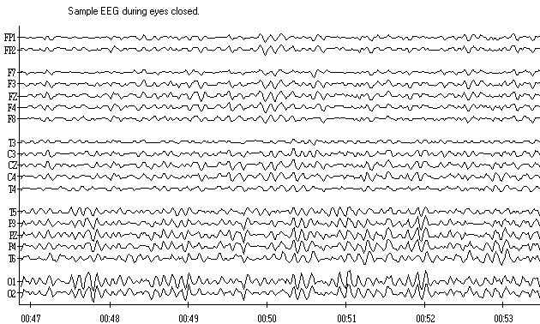
An EEG recording

Slide 7
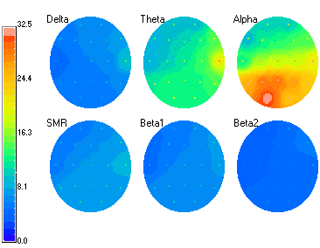
Topograph

Slide 8
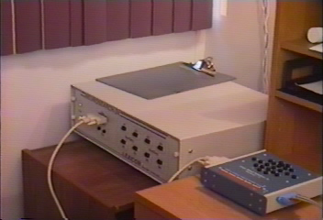

Slide 9
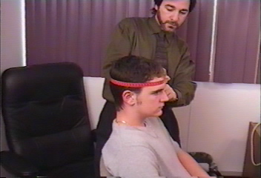
Measure circumference of the head

Slide 10
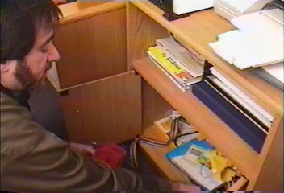
Determine proper cap-size

Slide 11
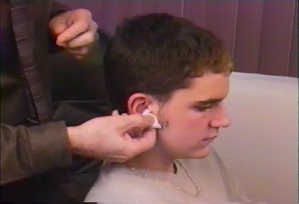
Prepare ear lobes for contact as ground and reference

Slide 12
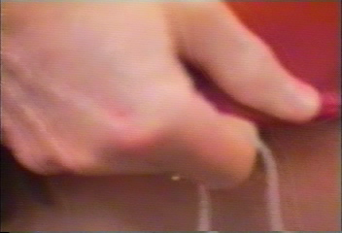
Place cap on subject’s head

Slide 13
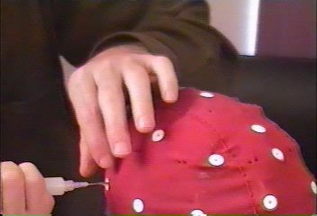
Insert contact gel at each scalp location

Slide 14
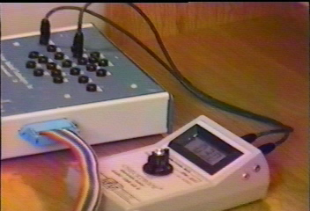
Measure impedance at each scalp location

Slide 15
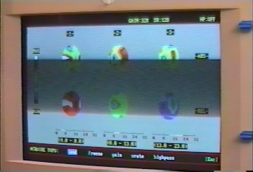
Collect EEG data

Slide 16
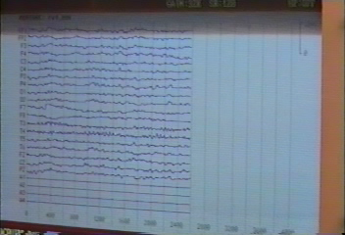
Raw EEG data

Slide 17
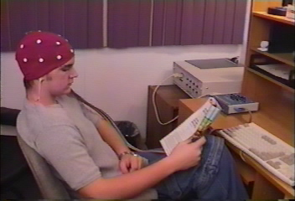
Collecting data while reading

Slide 18
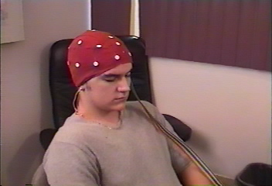
Collecting data while eyes are closed

Slide 19
NO BRAIN!

Slide 20
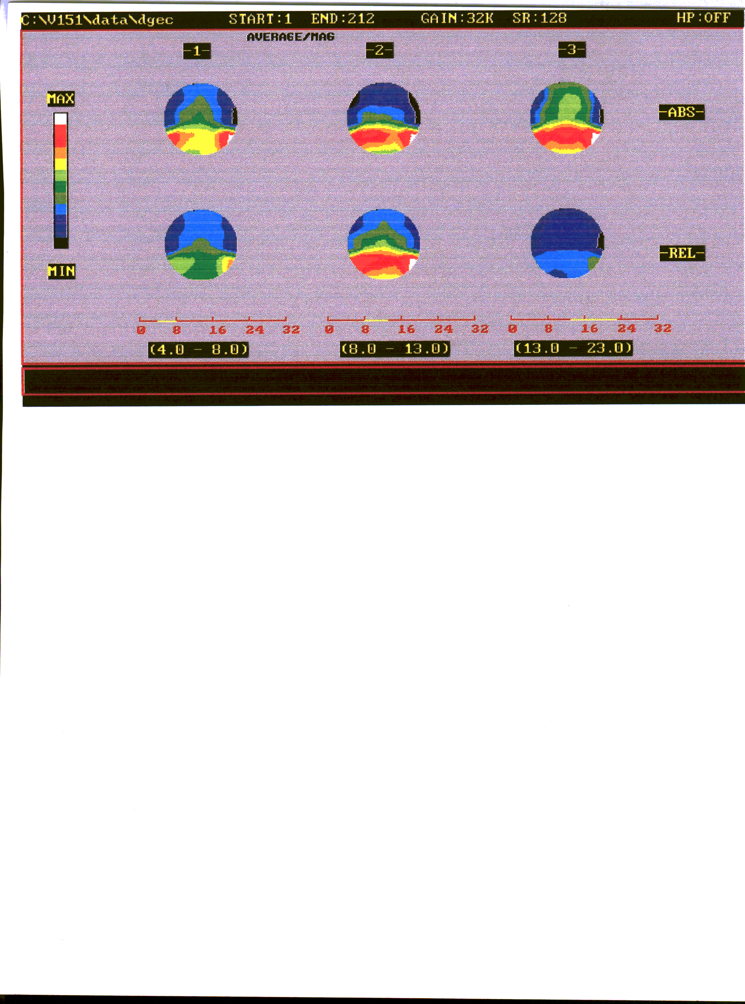
Theta Alpha Beta
Drowsy Daydreamy Alert
Brain map of eyes closed

Slide 21
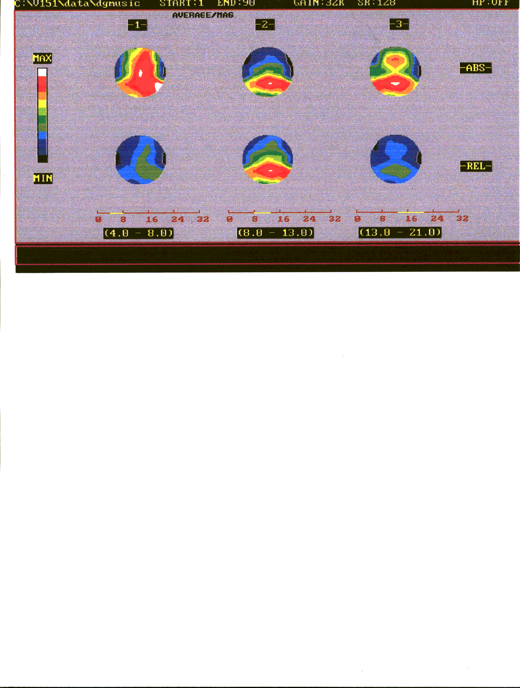
Theta Alpha Beta
Drowsy Daydreamy Alert
Brain map of listening to music

Slide 22
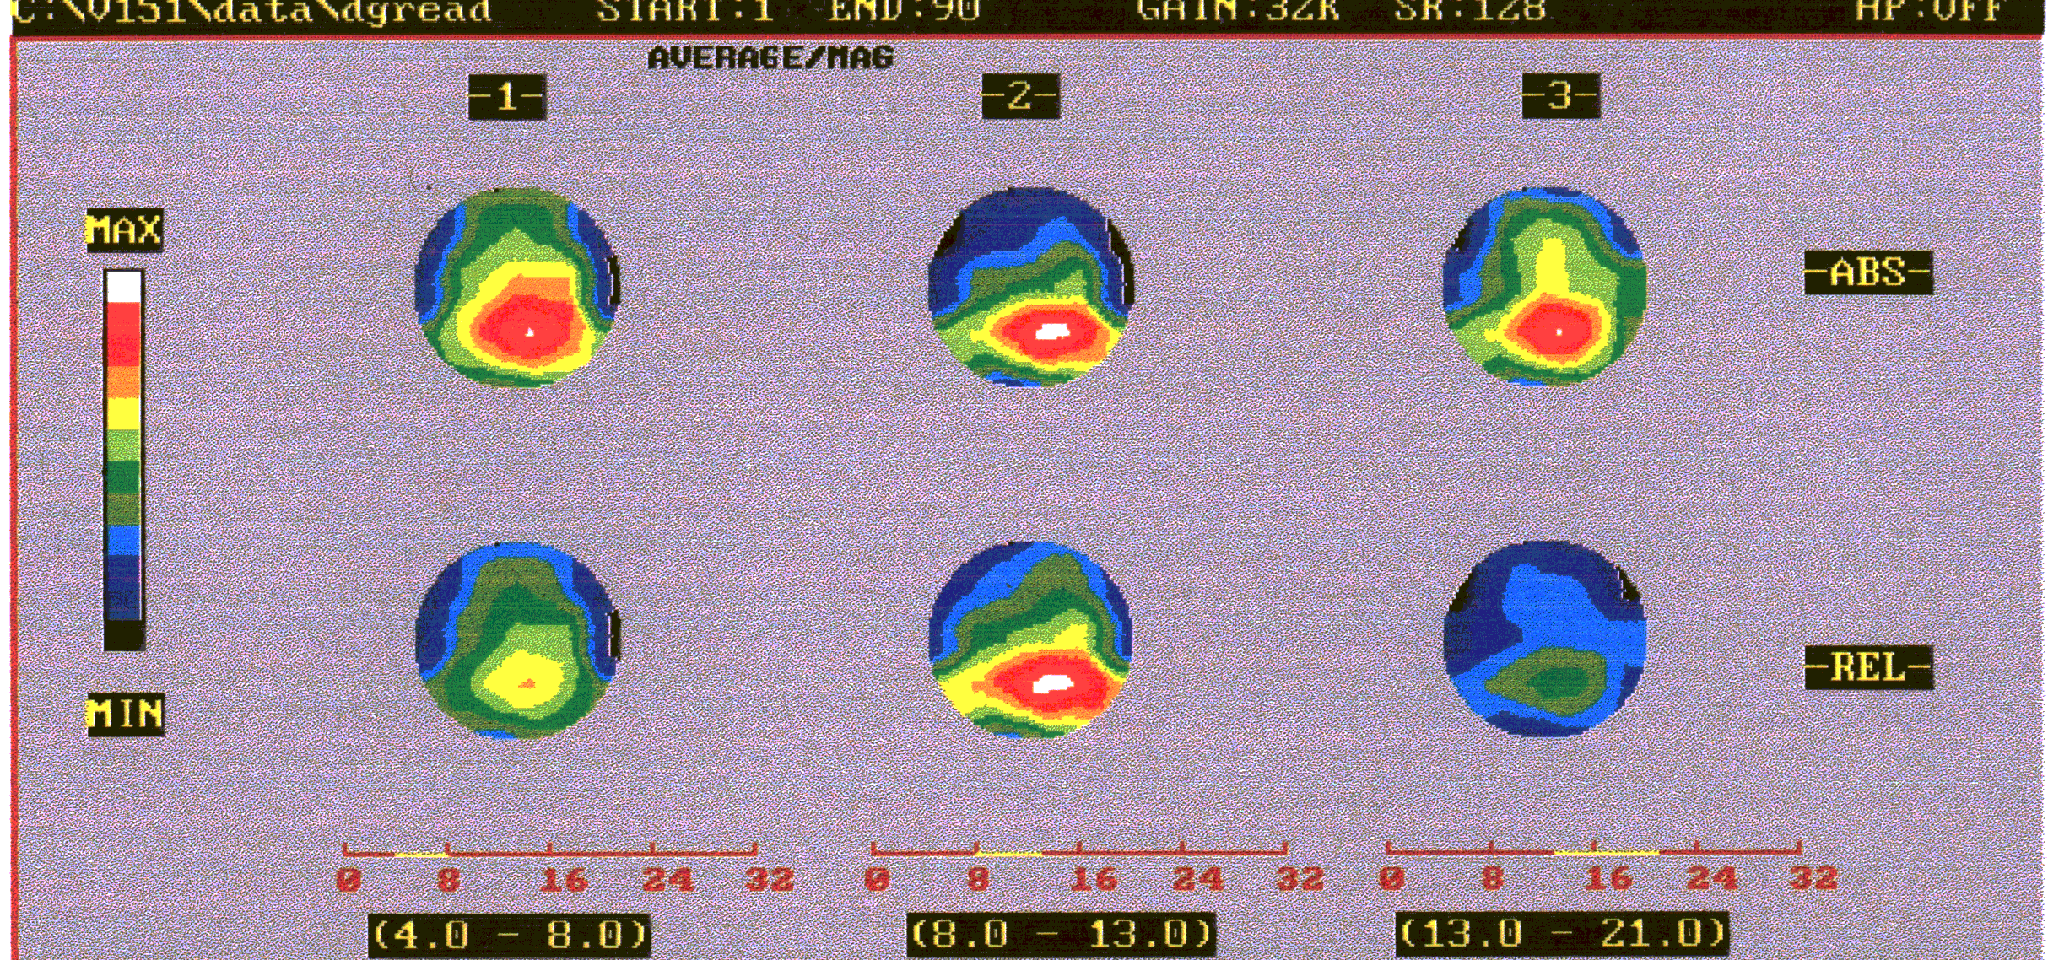
Theta Alpha Beta
Drowsy Daydreamy Alert
Brain map of reading

Slide 23
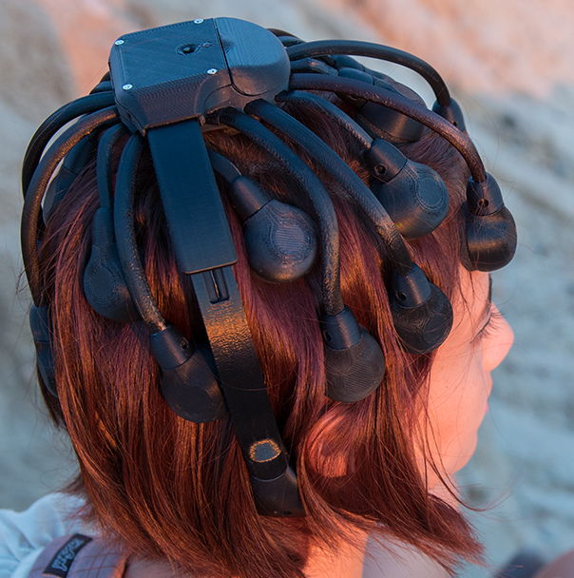
Cognionics Quick-20
  Spin-off from UCSD I.P.
  20-channel plus reference and ground

Slide 24
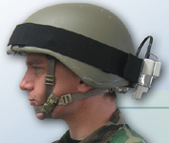
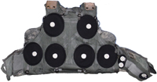
Quasar/Wearable Sensing
  D.o.D

Slide 25
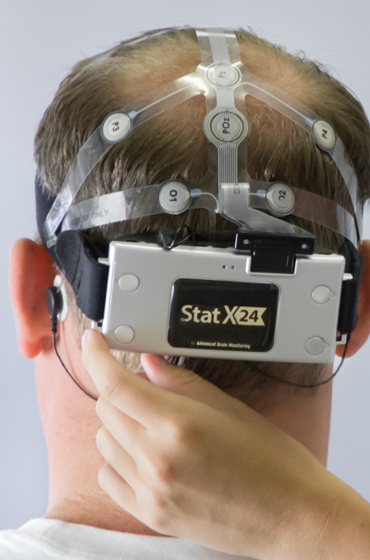
  Advanced Brain Monitoring
    FDA Cleared
    Disposable Gel Cap

Slide 26
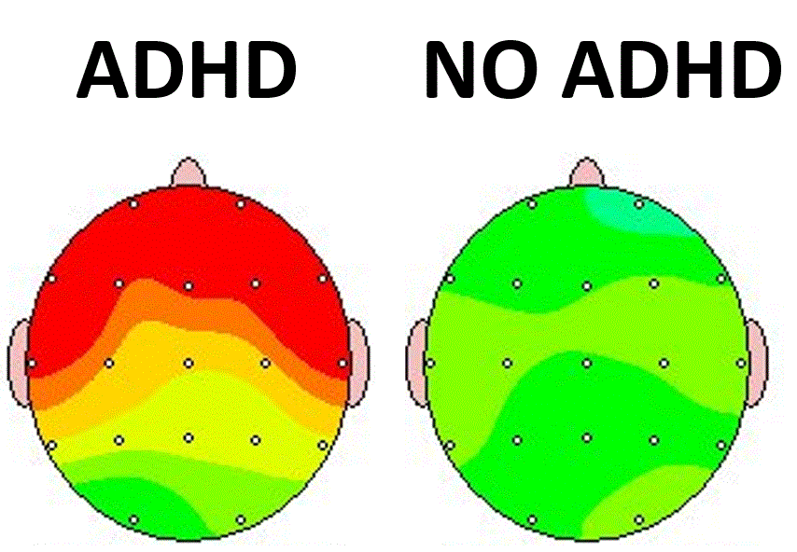

Slide 27
Neurofeedback
1 2 3 4 5 6 7 8 9 10

Slide 28
1991 Clinic News Broadcast

Slide 29
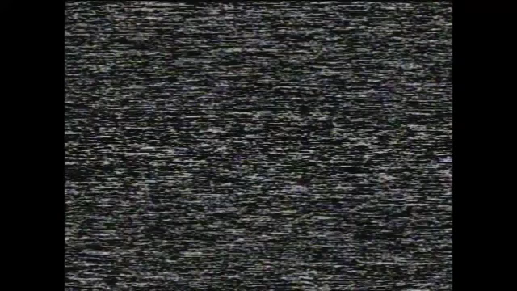

Slide 30
Neurofeedback
488+ independent studies
50+ years of research
34+ different applications
FDA Exempt
$2 Billion Market
2012: Rated Neurofeedback best intervention for ADHD

Slide 31
NASA
1 2 3 4 5 6 7 8 9 10

Slide 32
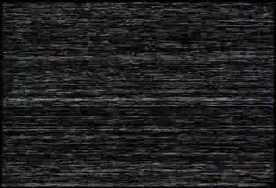

Slide 33
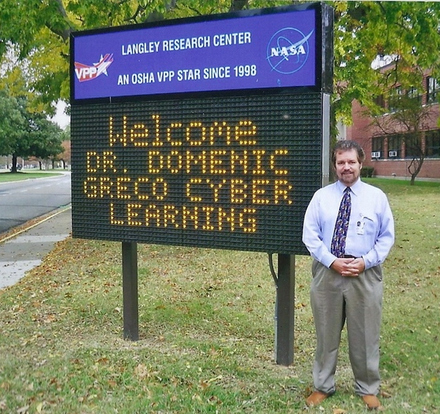

Slide 34

NASA Patent #'s 5,377,100 & 6,450,820

Slide 35
Video Game Neurofeedback
1 2 3 4 5 6 7 8 9 10

Slide 36
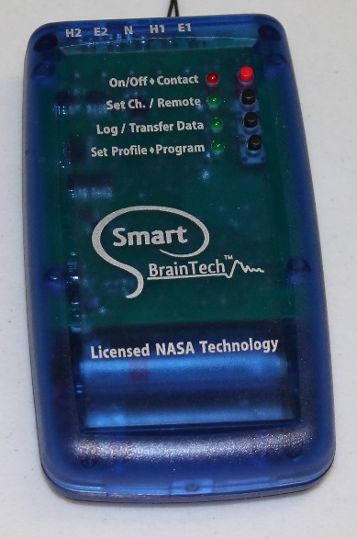
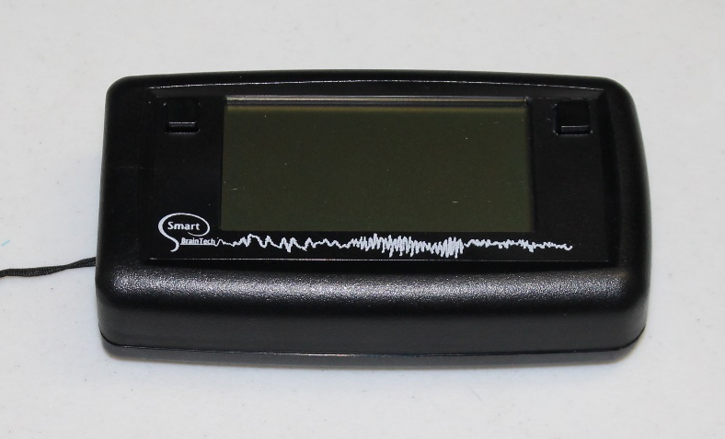

Slide 37
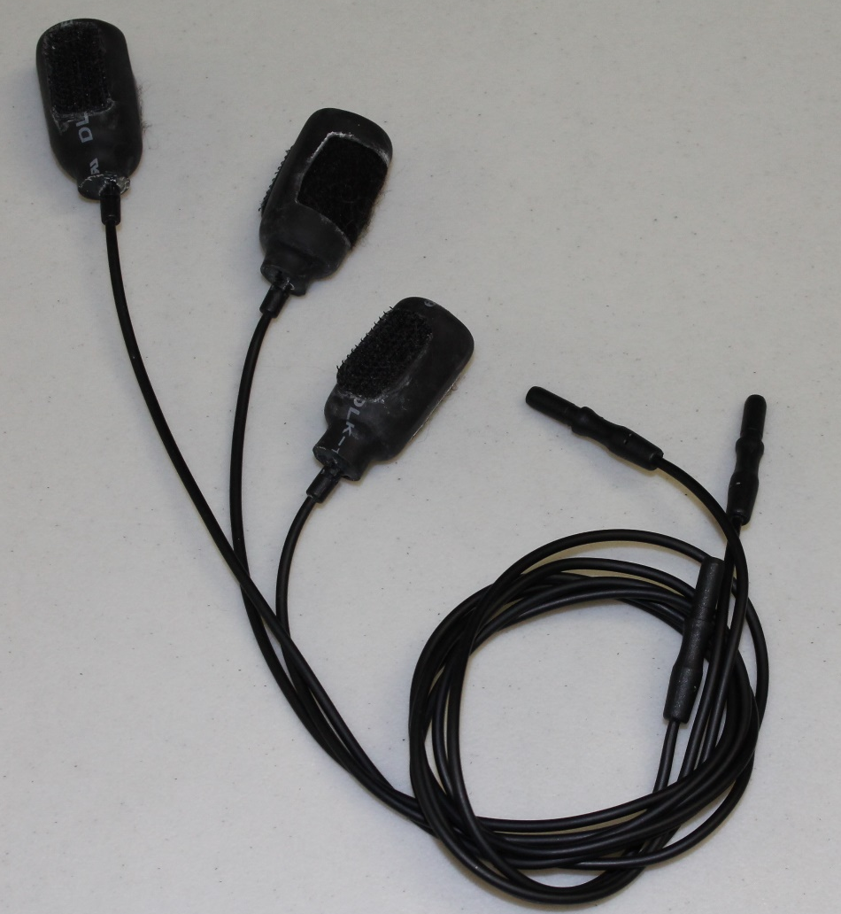
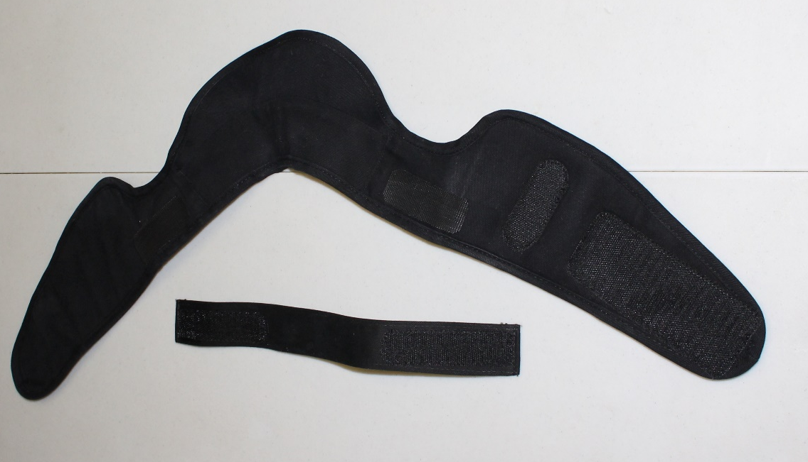

Slide 38
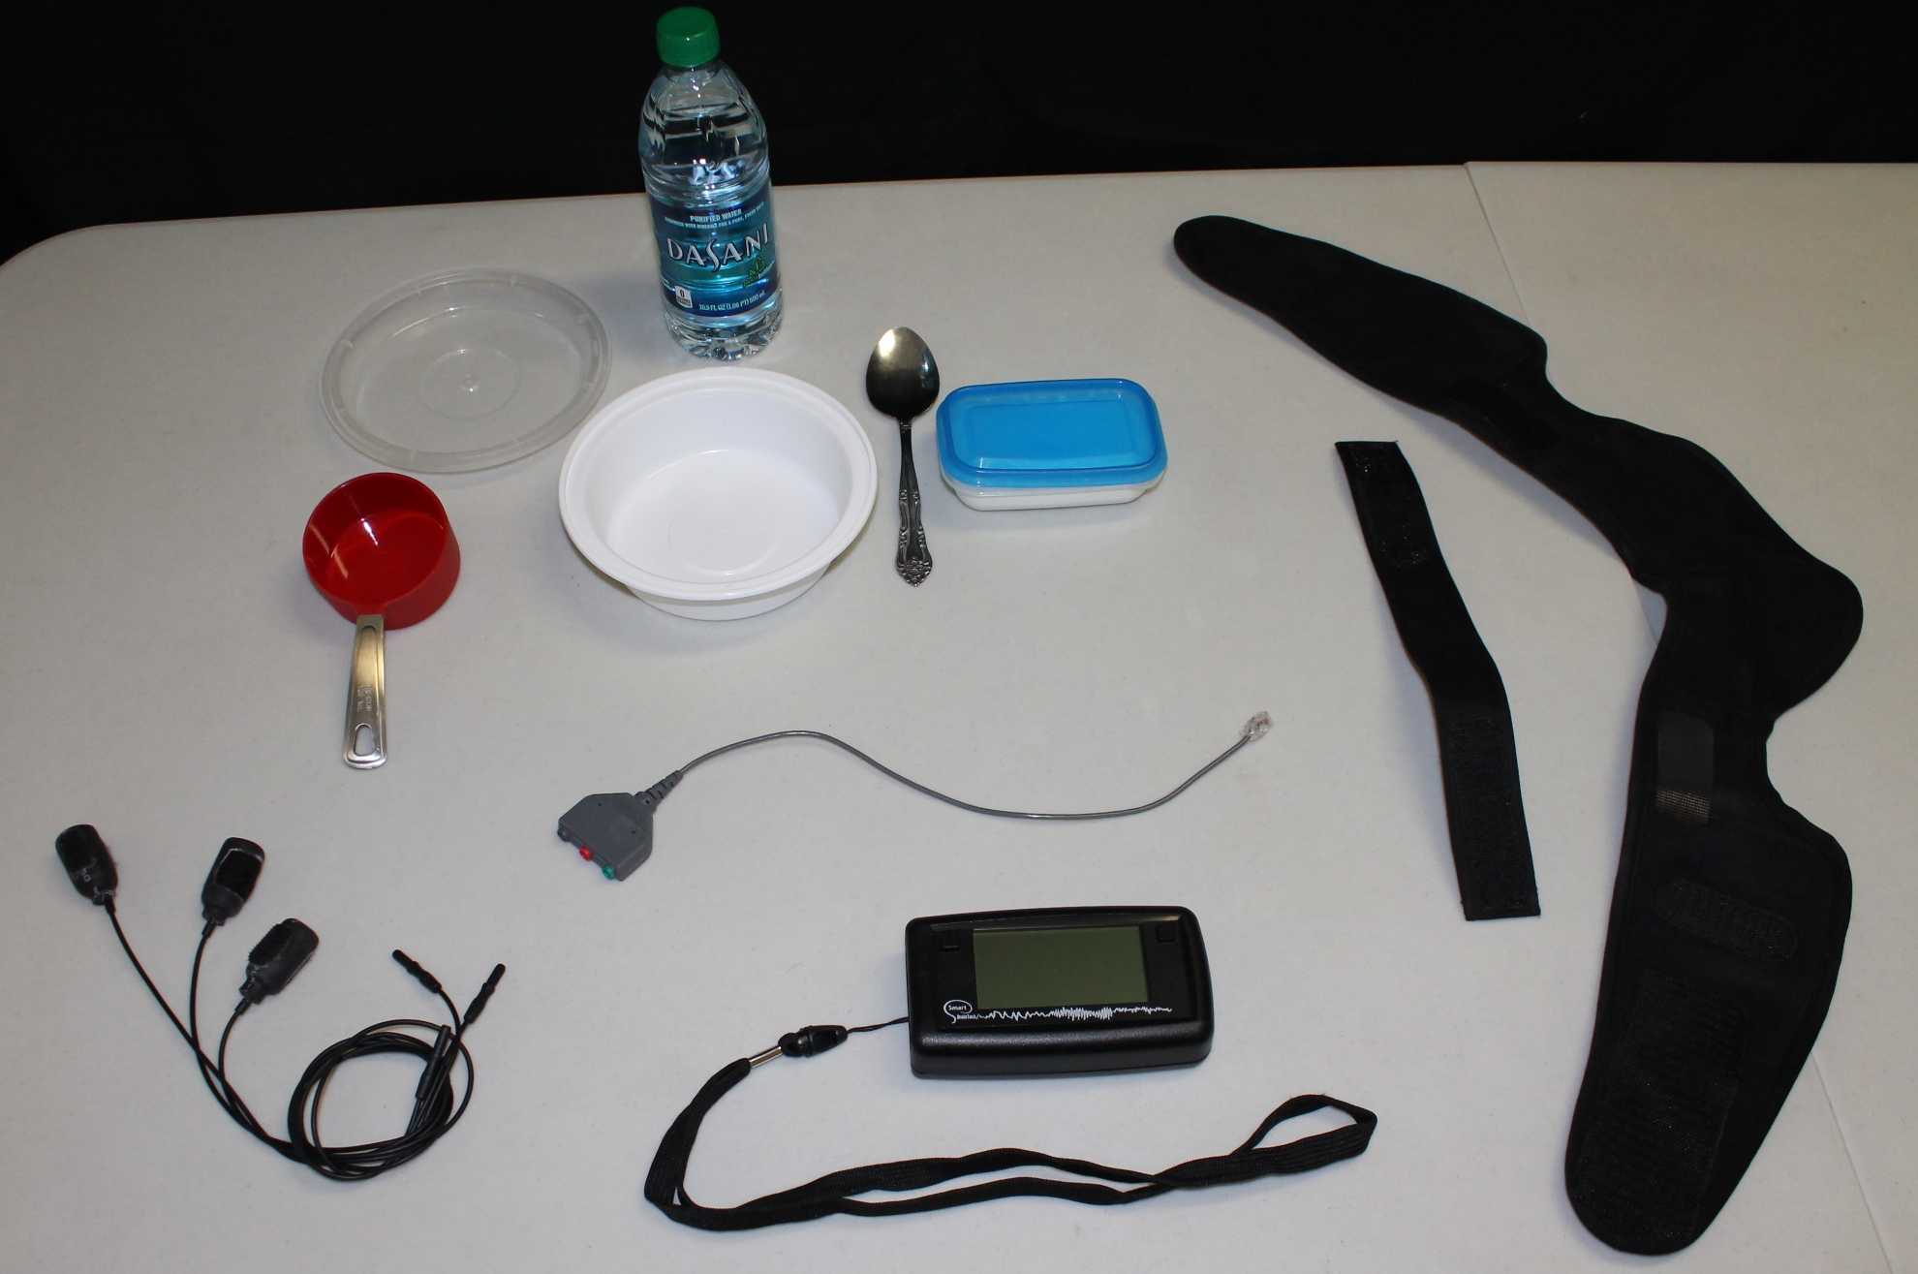

Slide 39
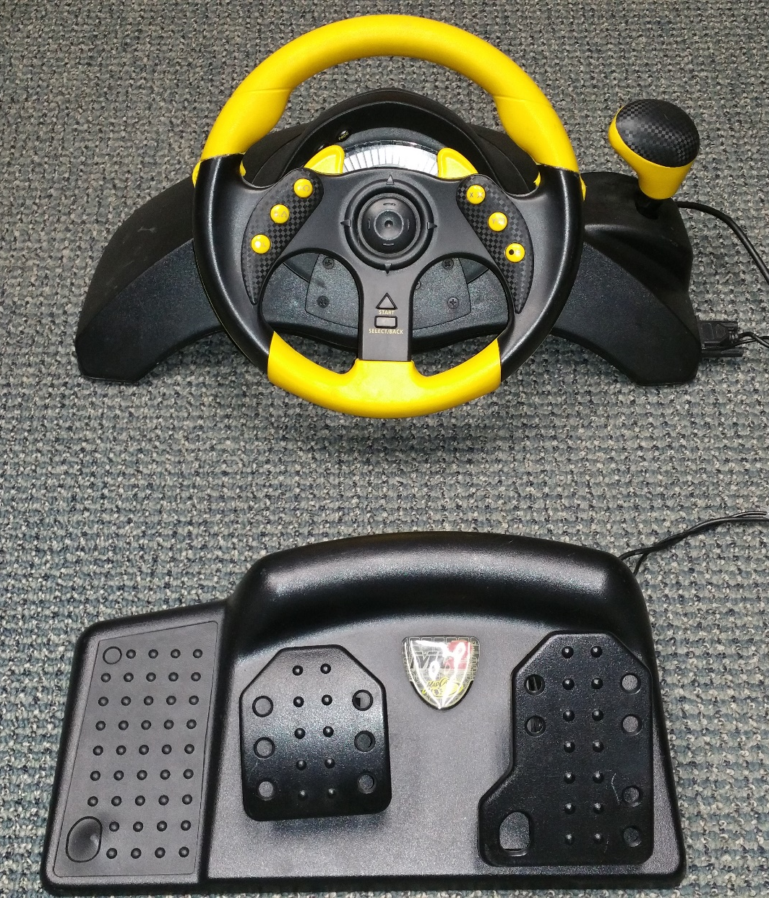

Slide 40
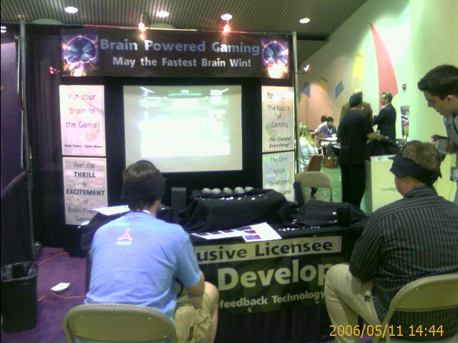

Slide 41
Narbis
1 2 3 4 5 6 7 8 9 10

Slide 42

Notes:
Dad’s eyetracking glasses

Slide 43
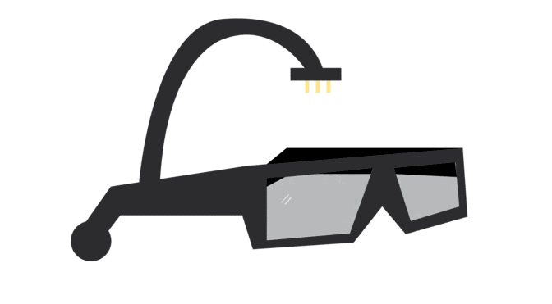

Slide 44


Slide 45
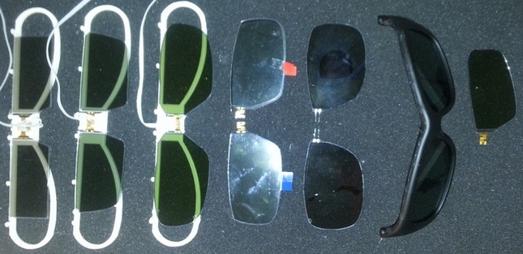
Notes:
Dad’s eyetracking glasses

Slide 46
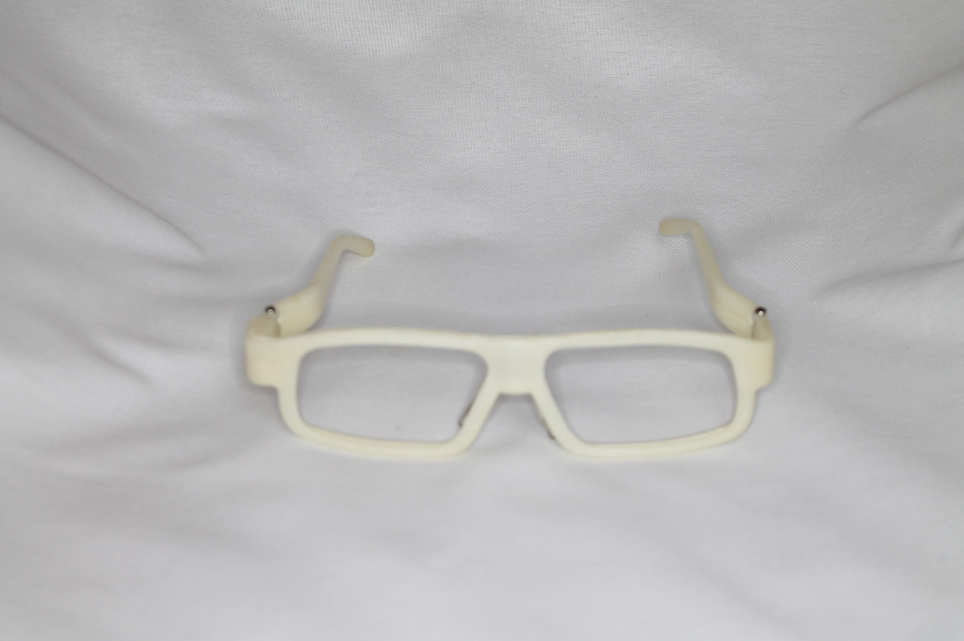
Notes:
Dad’s eyetracking glasses

Slide 47
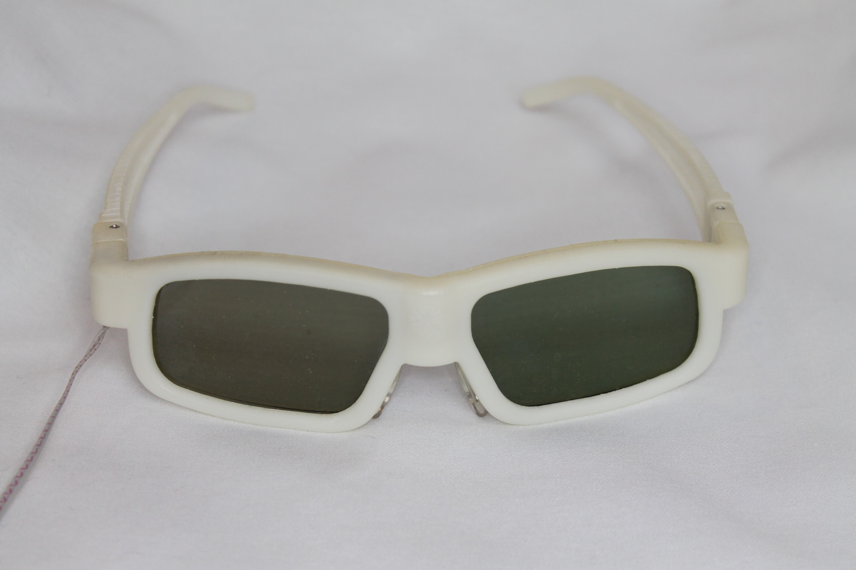
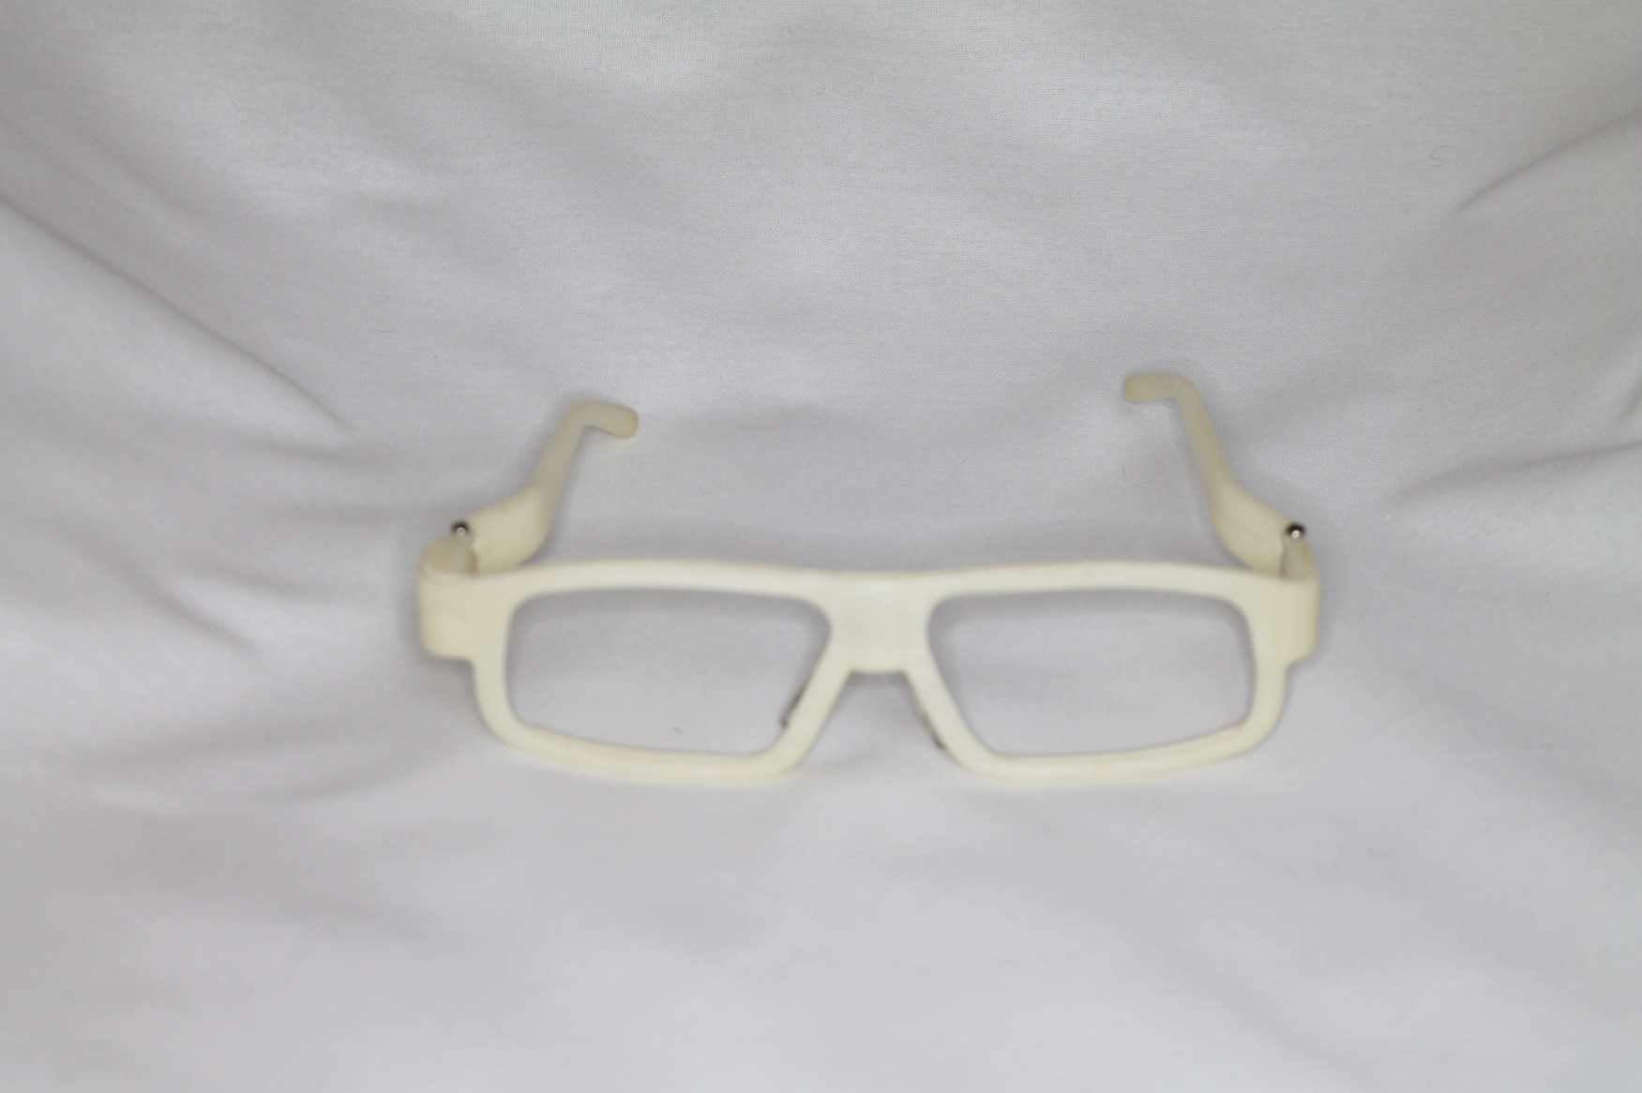
Notes:
Dad’s eyetracking glasses

Slide 48
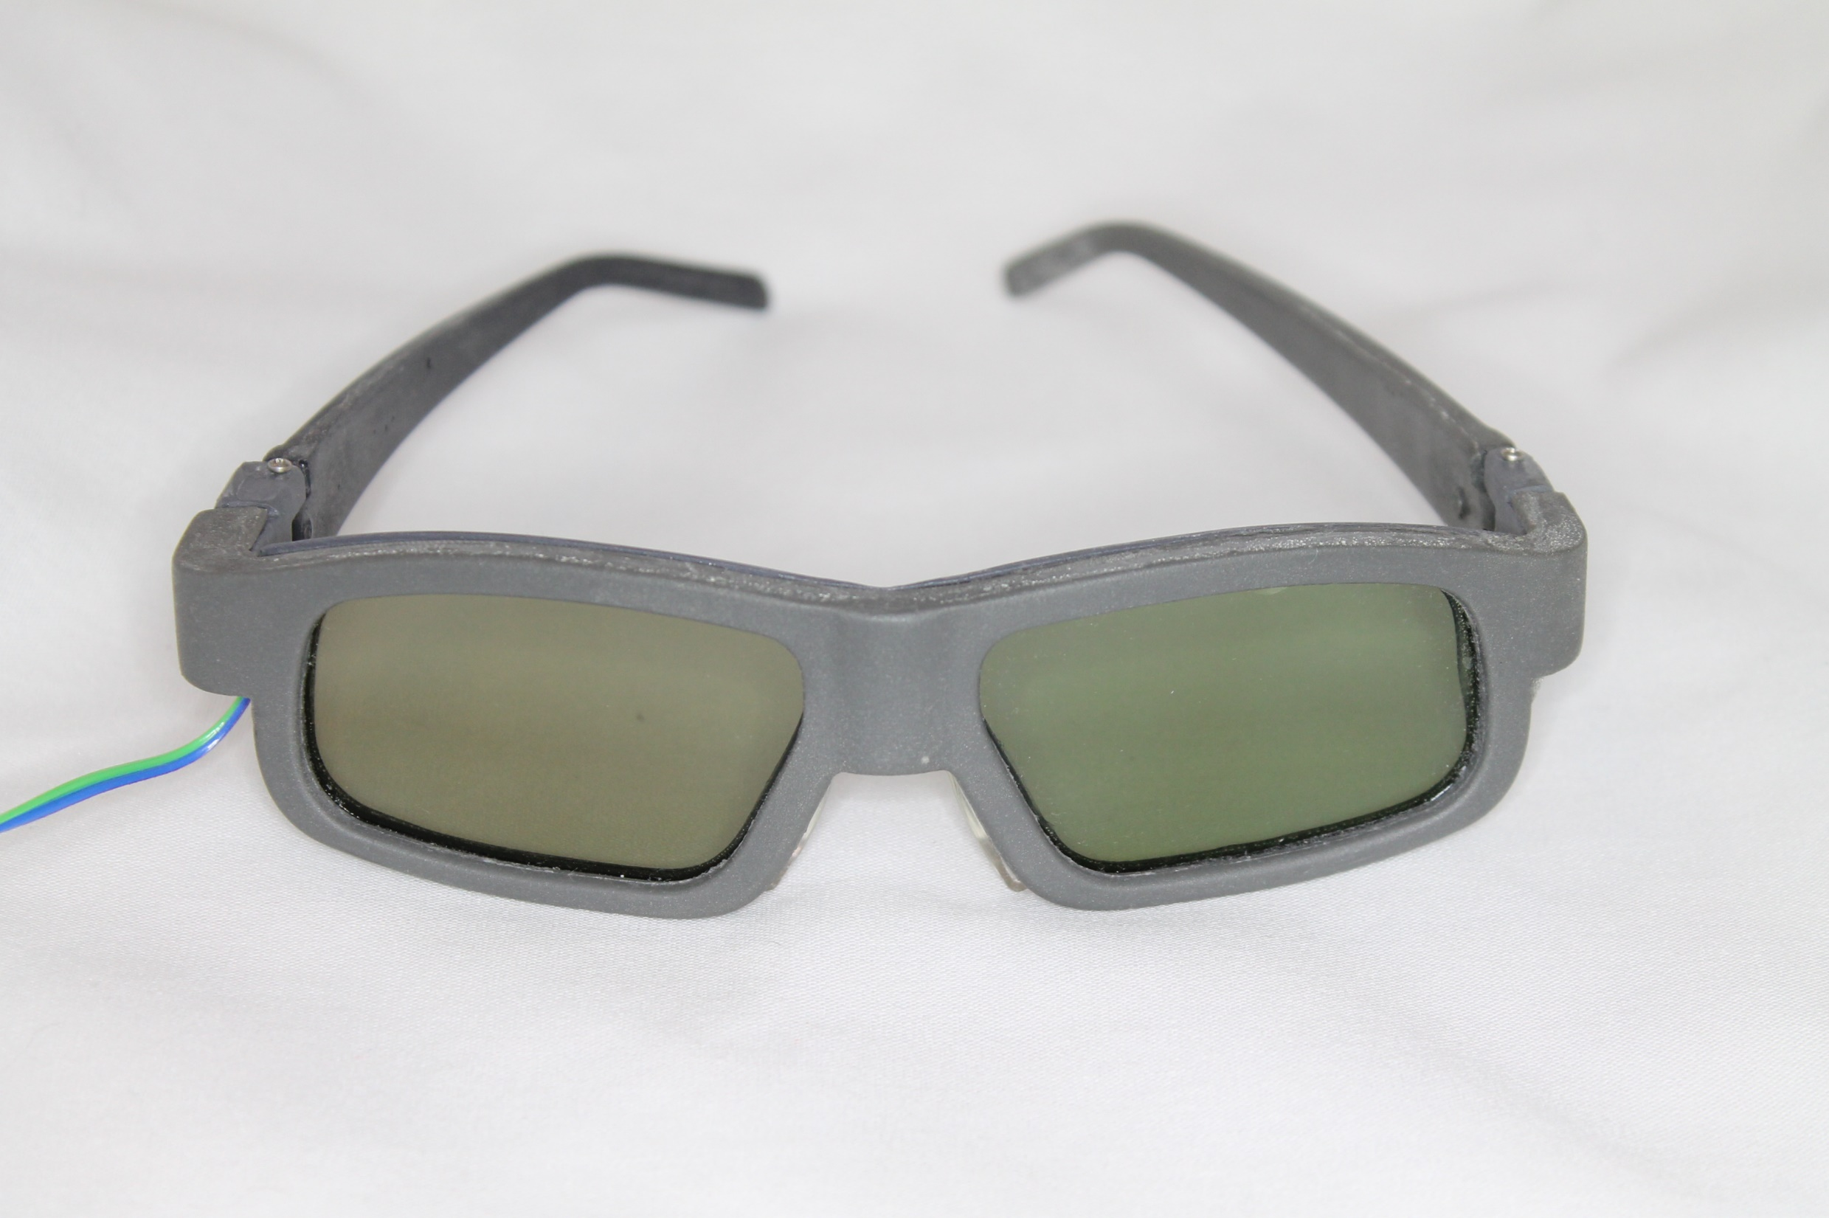

Notes:
Dad’s eyetracking glasses

Slide 49
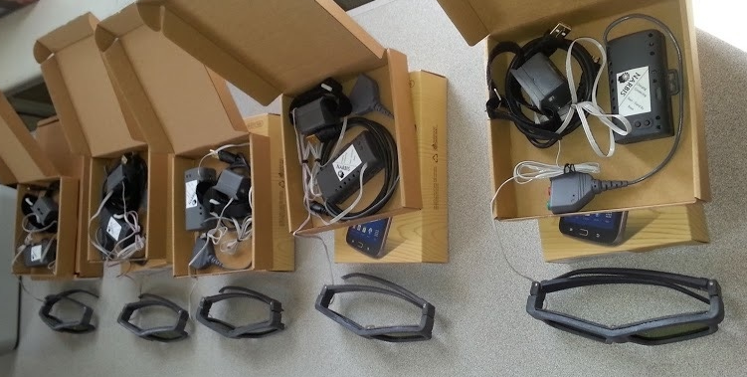
Notes:
Dad’s eyetracking glasses

Slide 50
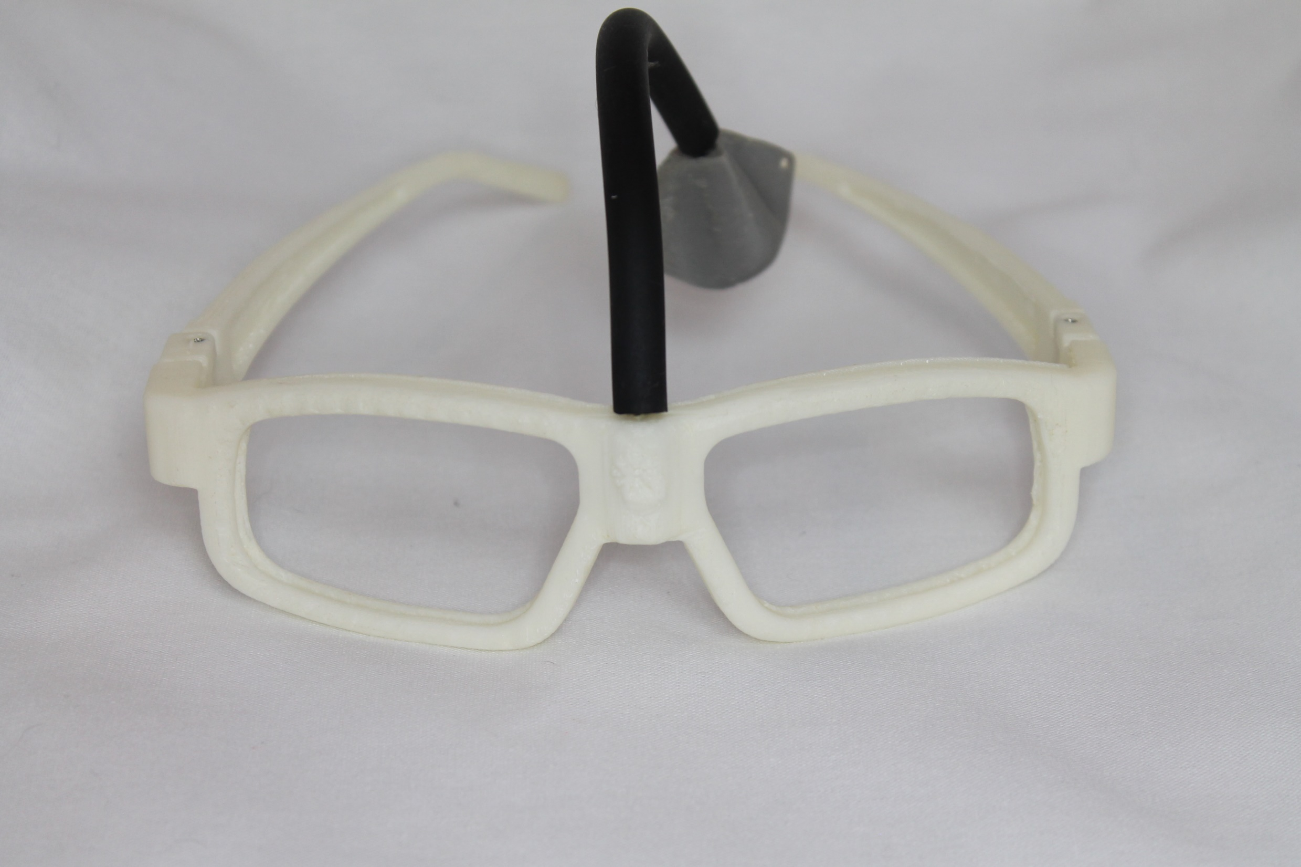
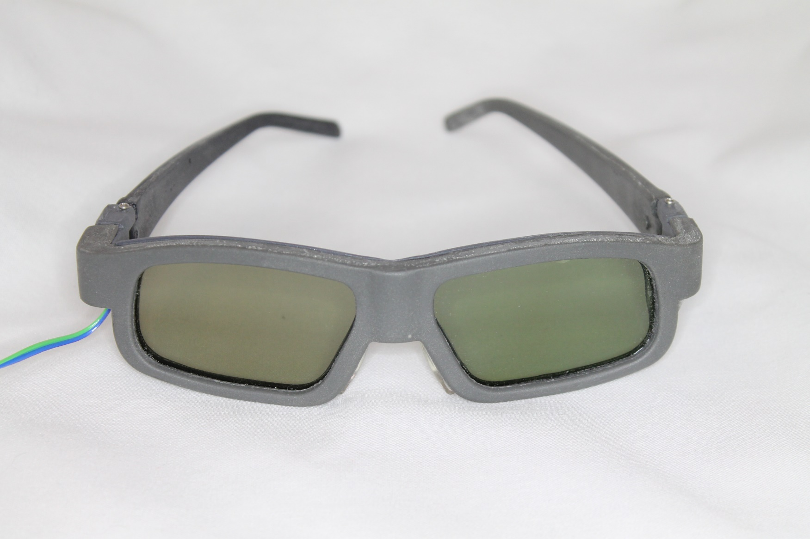
Notes:
Dad’s eyetracking glasses

Slide 51
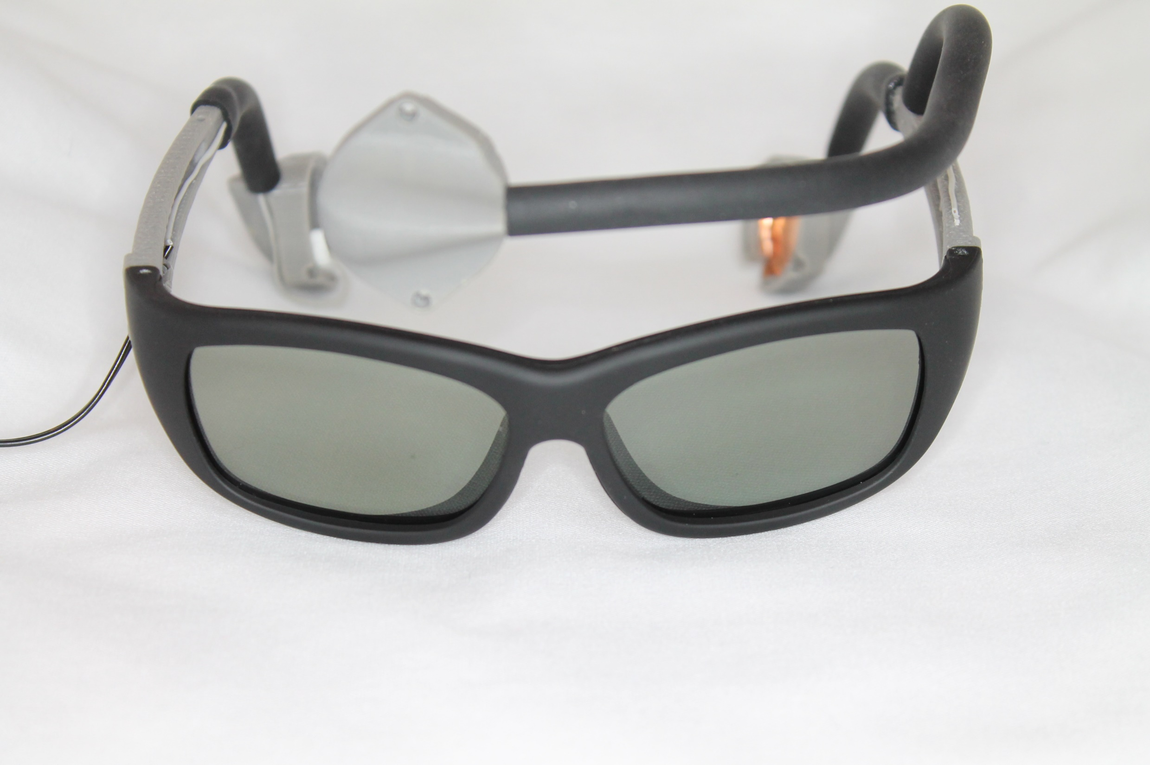
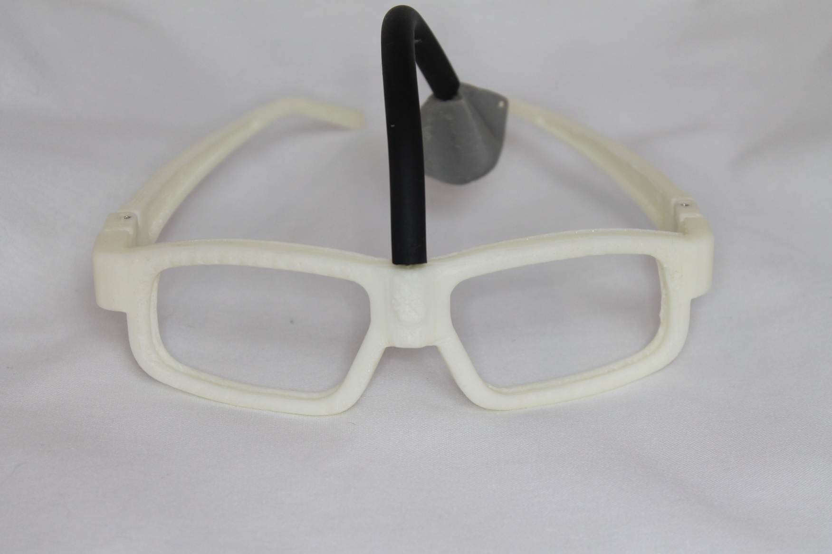
Notes:
Dad’s eyetracking glasses

Slide 52
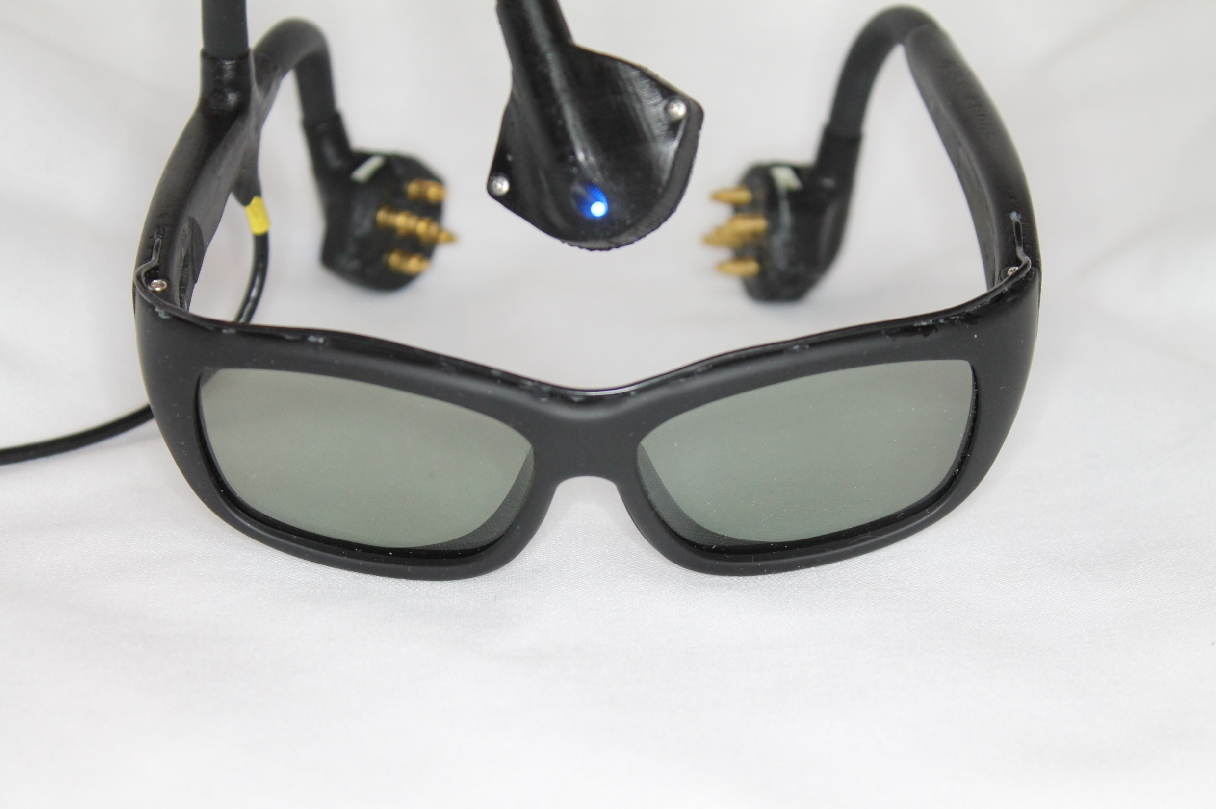
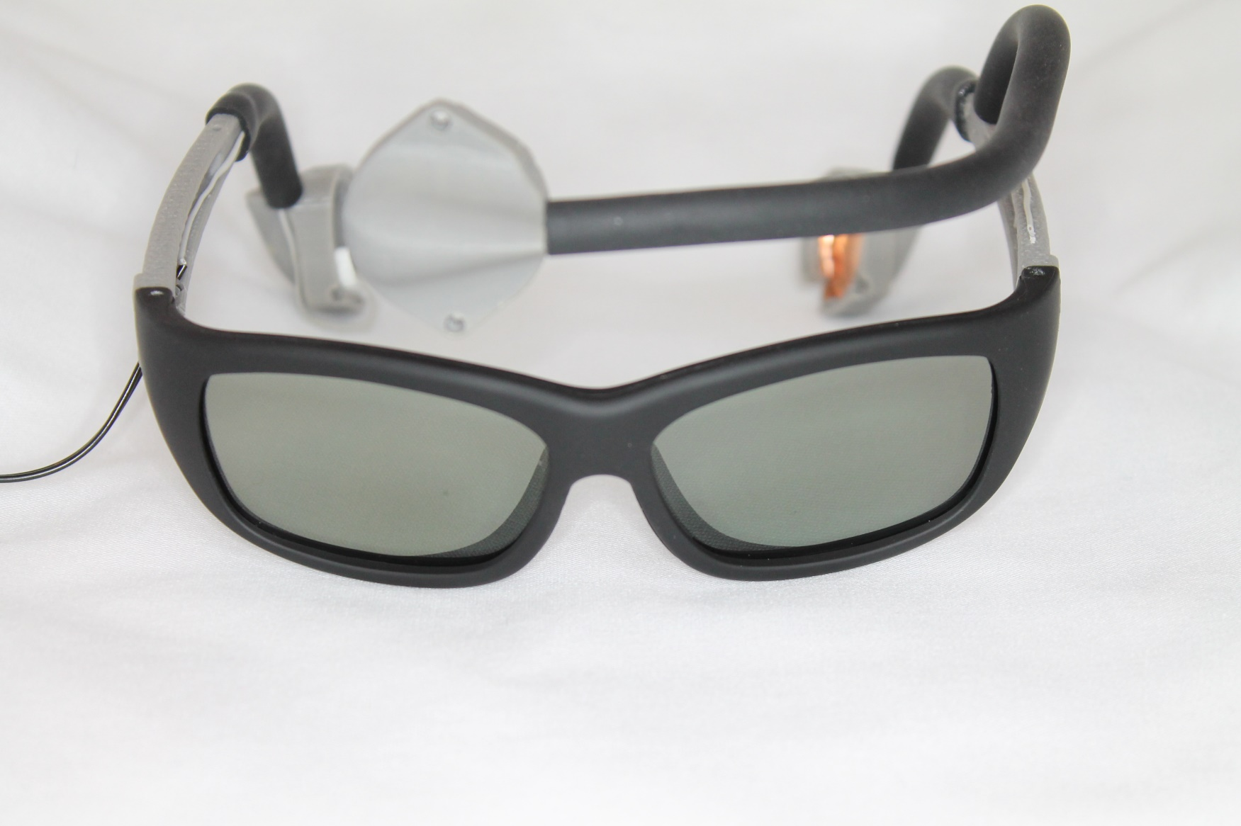
Notes:
Dad’s eyetracking glasses

Slide 53
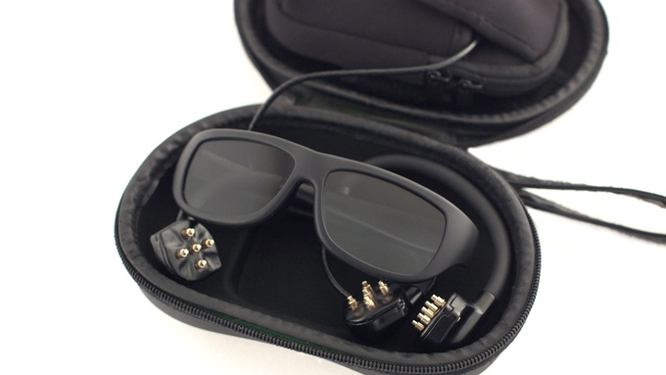
Notes:
Dad’s eyetracking glasses

Slide 54
“We have a 14 year old who has just completed 15 sessions of SMR training with the Narbis glasses while doing assigned summer reading.
His IVA continuous performance test scores went from the mid 60's to the mid 90's (standard scale so 90-110 is normal).
It has typically taken 20-30 sessions to get this big of a jump on the IVA.”
-Dr. Frank Harbin
Rome, GA
Notes:
Dad’s eyetracking glasses

Slide 55
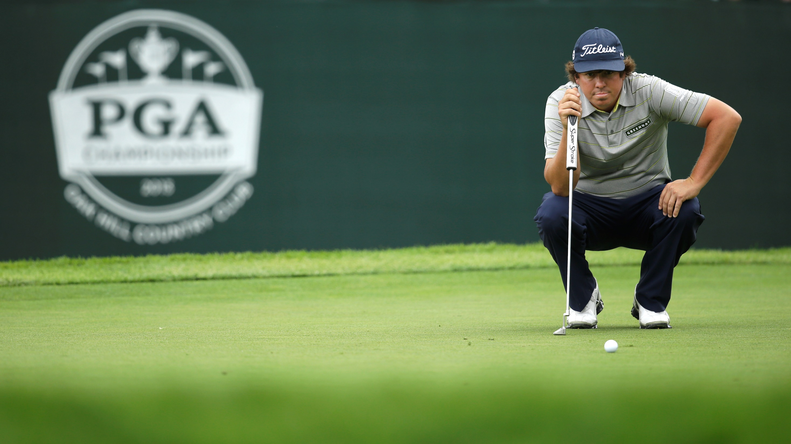
Notes:
Dad’s eyetracking glasses

Slide 56

Notes:
Dad’s eyetracking glasses

Slide 57
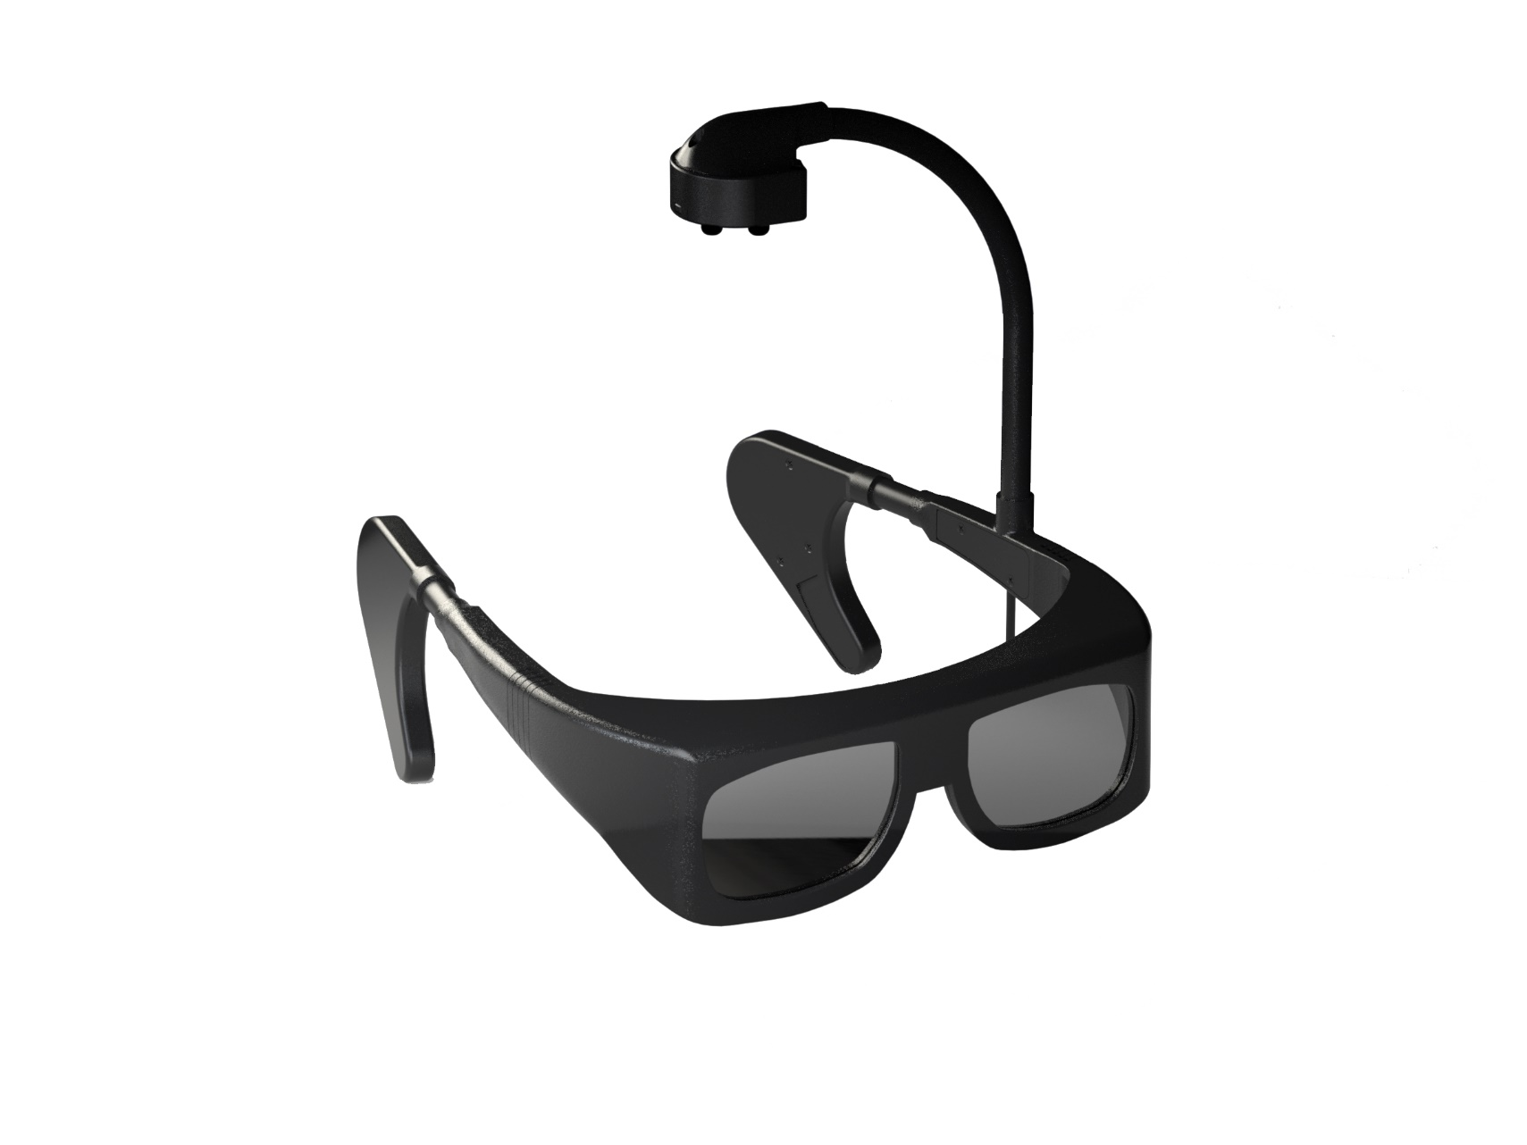
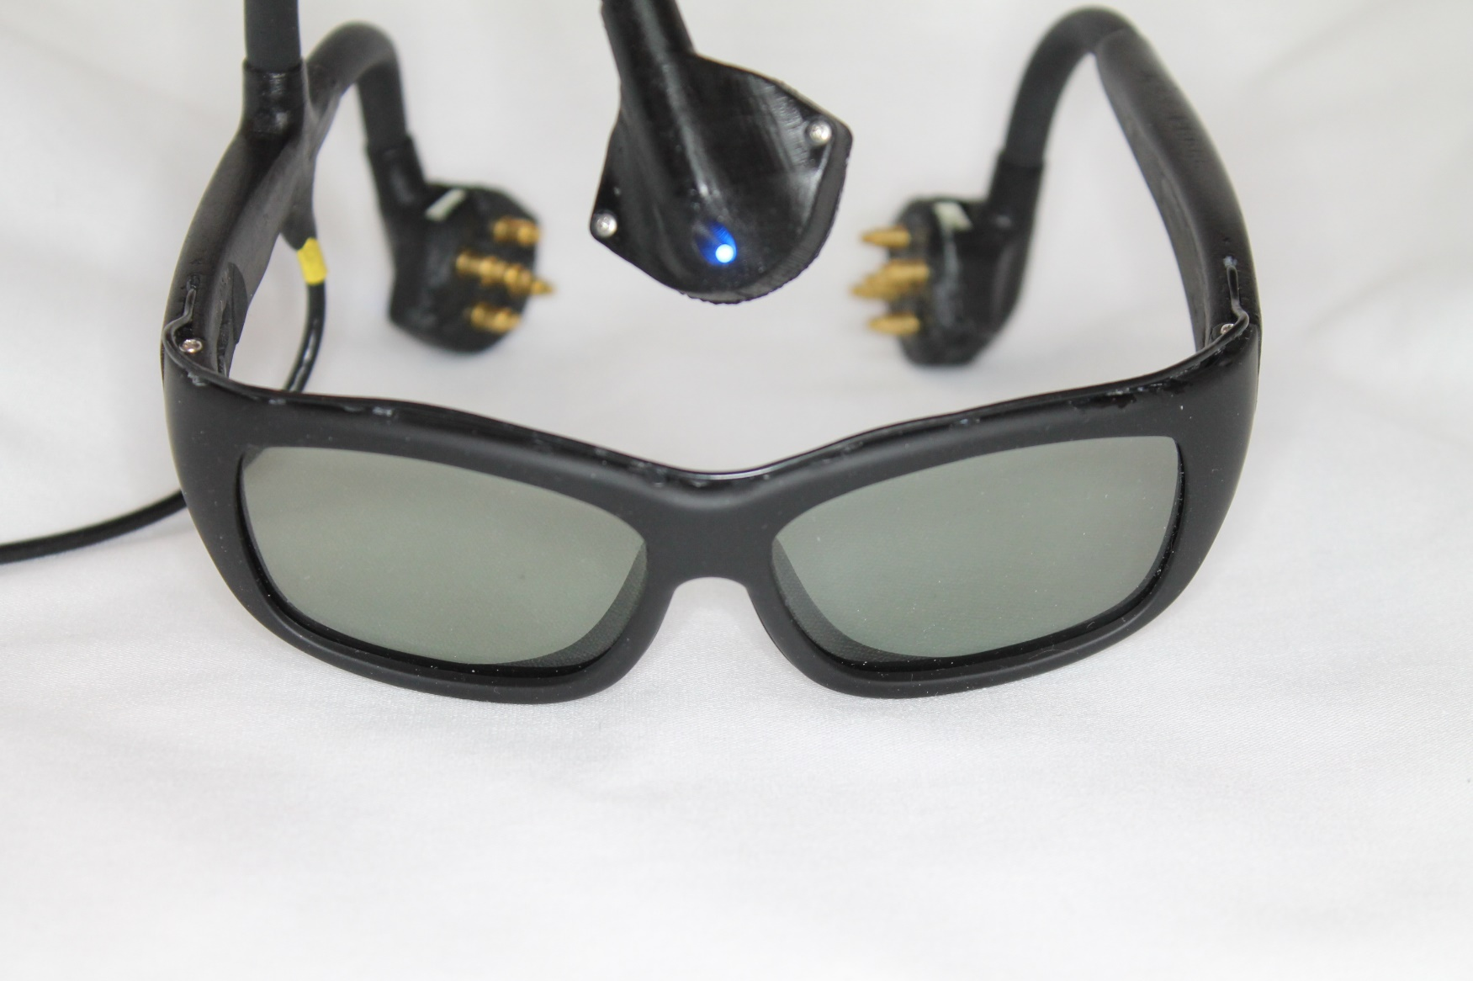
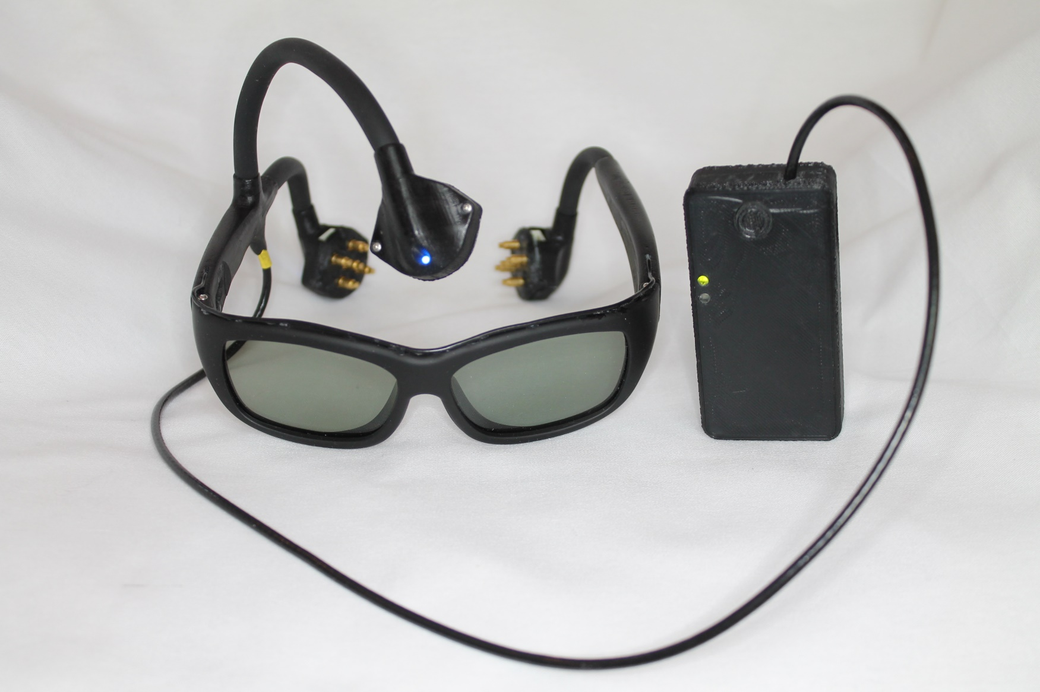
Notes:
Dad’s eyetracking glasses

Slide 58

Notes:
Dad’s eyetracking glasses

Slide 59
Narbis Demo
Notes:
Dad’s eyetracking glasses

Slide 60


Slide 61
Technology
1 2 3 4 5 6 7 8 9 10
Notes:
Dad’s eyetracking glasses

Slide 62

  Analog Front End
    ADS1299 T.I. EEG Chip
      8 channel
      1uVpp Input-referred noise
      250 SPS to 16 kSPS
      -110 dB CMRR
      Built-in Bias Drive Amplifier
      Lead off detection

Slide 63

  Active Electrode
    INA116 (UCSD)
      3fA typ Input Bias Current
      Buffered Guard Drive Pins
      84 dB CMRR

Slide 64



Slide 65


Slide 66


Slide 67


Slide 68



Slide 69
Operant Conditioning
1 2 3 4 5 6 7 8 9 10

Slide 70


Slide 71


Slide 72
Operant Conditioning
Static thresholding
Auto-thresholding
  Fuzzy Logic
  Simple Moving Average

Slide 73

Doing rocket science and calculus.
Training Bandwidths
  NASA Engagement Index
  B2/A+T
Relaxed, calm, cognizant.
Meditating or day-dreaming.
Drowsy and starting to fall asleep.
Sleeping.

Slide 74
Beta
Alpha + Theta

Slide 75


Slide 76


Slide 77
Teleneurofeedback
1 2 3 4 5 6 7 8 9 10

Slide 78


Slide 79
Future Tech
1 2 3 4 5 6 7 8 9 10

Slide 81
QEEG Diagnostics and
Bio-Neurofeedback
Devon Greco
Founder, Narbis.com
Devon, Pennsylvania
dgreco@narbis.com

