Slide 1
Truth Versus Truthiness
in Clinical Data
Mark Weiner, MD, FACP, FACMI
Assistant Dean for Informatics, Temple University School of Medicine
mark.weiner@tuhs.temple.edu

Slide 2
My mantra
In attempting to arrive at the truth, I have applied everywhere for information, but in scarcely an instance have I been able to obtain hospital records fit for any purpose of comparison. If they could be obtained, they would enable us to decide many other questions besides the one alluded to. They would show the subscribers how their money was being spent, what good was really being done with it, or whether the money was not doing mischief rather than good.

Slide 3
Truth
Definition by Merriam-Webster
(1) : the state of being the case : fact
(2) : the body of real things, events, and facts : actuality

Slide 4
Truthiness
Merriam-Webster's Word of the Year for 2006:
the quality of preferring concepts or facts one wishes to be true, rather than concepts or facts known to be true
How do we know something is true, especially in medicine?

Slide 5
Capturing the Truth
Head versus Heart
Are men being overtreated, or are women being undertreated for heart disease?
Men do get more invasive cardiac procedures than women, but…
Should all post menopausal women use hormone replacement therapy?
We used to think so, but…
Should all women between 40-50 receive mammograms?
Some women get cancer below age 50, but…
Should medical care be a 24/7 operation?
Seems to make sense, but..

Slide 6
IEEE Signal Processing in Medicine and Biology Symposium
How does Signal Processing lead to the truth?
How many ways can signal processing lead you astray of the truth?
What assumptions do you make about the validity of the signal/data being processed?
What assumptions do you make about the appropriate analysis?
Data and Analysis

Slide 7
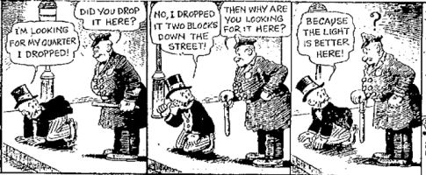
IEEE Signal Processing in Medicine and Biology Symposium
What assumptions do you make about the appropriateness of the data for the truth you seek?
Data and Analysis

Slide 8
IEEE Signal Processing in Medicine and Biology Symposium
What assumptions do you make about the interpretation of the results?
Statistical significance versus clinical significance
Do your results advance/alter conclusions made through other means?
Is there a threshold where your results change clinical decisions
How do you KNOW your results are correct?
Interpretation and implementation of results

Slide 9
Data Substrate for Signal Processing: IEEE Meeting
EEG Data to find specific epileptiform patters
Image data to find lesions
Sound data to detect important clinical findings like wheezing
Movement sensing to detect suboptimal posture, or apnea
High volume/velocity of data that is sensibly related to the clinical issue of interest
High confidence in the gold standard
Do the findings support a clinical decision?

Slide 10
My type of Signal Processing
Clinical and administrative data collected through the routine operation of the health system
Visits and missed visits
vital signs
lab results
meds prescribed/picked-up/taken
diagnoses assigned
procedures performed
NLP-requiring things like clinic notes, and other narrative reports
Image processing
Other telemetry monitoring

Slide 11
My type of Signal Processing
Sparse,
Not continuous
Systemically and non-systemically missing data
Temporal Pattern of data, regardless of the results, MAY (but not necessarily) be associated with the outcome
Disagreement on the presence, absence, or even the nature of the outcome
Please help me with MY signal processing

Slide 12
Changing landscape for the information substrate of my type of signal processing
Meaningful use –incentives for better use of EHRs
Increasing requirements for quality measurement and reporting are driving efforts at more comprehensive (and electronic) data collection, storage and analysis among provider organizations and payers.
E-prescribing is enabling better assessment of the disjoin between drugs that are ordered and drugs that are actually picked up
E-prescribing is not transmitting drug discontinuation orders in the EHR – but that is a different story!

Slide 13
Changing landscape for the information substrate of of my type of signal processing
Changing paradigms for reimbursement
Driving creative applications of information technology favoring health information exchange and novel analytic techniques to assess cost effectiveness of interventions in a dynamic environment using routinely collected clinical data
Increasing use of EHRs means that comprehensive, longitudinal data is increasingly available on larger numbers of patients.

Slide 14
Common assumptions that are not quite true
Data Accuracy
The billing data is so inaccurate, it cannot be used for research
If you alter your notion of a billing code from “the patient definitely has this disease” to “the patient has something like this disease” or “the doctor is worried about this disease,” and incorporate that ambiguity into your analysis, you will be much happier.

Slide 15
Common assumptions that are not quite true
Value of “simple” query tools
“Self service data tools” that show dashboards and enable simple queries to be performed by high level investigators and administrators, translate into the need for fewer dedicated data analysts
Many high level investigators and administrators don’t have the time or interest in conducting independent explorations.
Some administrators like dashboards (a LOT!)
A very good self service tool will raise the basic understanding of data by an end user that will increase the sophistication of the query posed – but there is still plenty of hopefully more-worthwhile work to do by a team of data analysts!

Slide 16
Common assumptions that are not quite true
Study feasibility
If I look retrospectively at observational data and find X patients with an acute disease Y over time period Z, I can expect to enroll X patients with disease Y over time period Z
Your ability to retrospectively recognize patients who have a disease does NOT mean you can proactively identify them with enough lead time to enroll them in a trial (eg interventions to prevent ICU admissions)
I need to program my database query tool with ALL inclusion and exclusion criteria to assess study feasibility
Especially with some exclusion criteria, sometimes it is better to “play the odds,” and not actually query on the criteria

Slide 17
Common assumptions that are not quite true
Reporting Results
Results of observational analyses should be presented in a manner analogous to clinical trials – the relationship between an exposure and outcome should be expressed as a single point estimate and confidence interval
AT BEST – ignores the robustness of similar or alternate findings generated under different assumptions
Your one answer may be spuriously right or wrong.
AT WORST – a finding may be a cherry-picked result

Slide 18
Patrick Ryan, Observational Health Data Sciences
and Informatics (OHDSI) Overview, 5/14/14

Slide 19
Patrick Ryan, Observational Health Data Sciences
and Informatics (OHDSI) Overview, 5/14/14

Slide 20
Red flags
Show me an investigator that comes to a data analyst looking for patients to enroll after a study protocol is written, and I’ll show you a study that is doomed to fail!
Just as you would not develop a study protocol without a statistician at your side, you need a data analyst early on in the process
Show me a data analyst who asks an investigator for codes of interest before he can run a query looking for patients with a diagnosis of interest, and I’ll show you an investigator who needs a new data analyst!
The query process is iterative and starts with an analyst’s presentation of at least a frequency count of common codes

Slide 21
Caveats in Signal Processing to Improve Clinical Care
Is the data Accurate?
Accuracy = truth?
If the information system says a patient has asthma, then the patient has asthma
Accuracy = true representation of the source data?
If the information system says a patient has asthma, then the source data for the patient includes a code for asthma or other diagnostic testing results consistent with asthma

Slide 22
Caveats in Signal Processing to Improve Clinical Care
Is the data Accurate?
Clinical data is used in real clinical practice so it must be accurate except…
Physician patient communication/misunderstandings
Busy doctors don’t code/document everything
Idiosyncrasies of the clinical setting in which data is collected
Ambiguity inherent in the practice of medicine
Code creep-
Early codes before diagnosis of gallstones is confirmed may suggest simple abdominal pain
Changing billing rules can alter the recording of diagnoses
Adapted and expanded from O’Malley KJ, Cook KF, Price MD, 22 KR, Hurdle JF,
Ashton CA Measuring Diagnoses: ICD Code Accuracy Health Services Research 2005. 40:1620-39.

Slide 23
Caveats in Signal Processing to Improve Clinical Care
Research using billing and even EHR data must account for all of the realities inherent in the underlying data
Absence of evidence is not evidence of absence
Just because you don’t see evidence of a disease doesn’t mean the patient doesn’t have the disease
Vigilance in exploring for a condition, even if it turns out NOT to be present, has clinical relevance
Providers may look harder for the presence of a condition or a physical finding in some patients more than others
Clusters of visits are significant, but not necessarily directly related to the condition being studied
Someone with a lot of visits related to asthma may get a cholesterol drawn sooner than a patient without asthma whose cholesterol management is being done more routinely.

Slide 24
Caveats in Signal Processing to Improve Clinical Care
To find patients with a certain disease, you need to consider all the ways the disease may be represented in diagnosis codes and ancillary test results
URI/bronchitis/tracheitis/pharyngitis/sinusitis are harder to reliably distinguish that most people would like to think.
Green sputum is not always bacterial and Yellow sputum is not always viral
Broad definitions must be considered in the assessment of both risks and outcomes

Slide 25
Caveats in Signal Processing to Improve Clinical Care
Left Censoring
the first instance of a disease in the data is not necessarily the time the disease first appeared.
Absence of a disease in the data does not mean the condition does not exist
Right Censoring
Data must cover a time interval long enough for the exposure to result in an outcome that is captured in the data.
Does the exposure influence the occurrence of the outcome in 1 year, or 5 years?

Slide 26
Caveats in Signal Processing to Improve Clinical Care
Data from uncaptured clinical settings
Received Angioplasty at big city institution A. Hospitalized at local community hospital for GI bleed.
Logical inconsistencies across information systems
Allergy to Drug Z listed from data source A
Prescriptions for Drug Z from data source B
Temporal issues
Presence of murmur AFTER echo report (or cardiology visit)
Heart failure reported AFTER starting ACE-I

Slide 27
Caveats in Signal Processing to Improve Clinical Care
Uncoded information
Patients with certain characteristics are cared for in certain locations of the hospital
Regional (and personal) variation in documentation styles

Slide 28
Caveats in Signal Processing to Improve Clinical Care
Unmeasured confounders
Treatment bias
Medications are prescribed because the provider believes the patient needs them
Sicker patients may systematically receive certain types of medicine more than others
Testing bias
Patients who test positive for certain tests are more likely to receive additional testing (related or unrelated)

Slide 29
Caveats in Signal Processing to Improve Clinical Care
Unmeasured confounders
Formulary issues
Insurer rules limiting the use of some meds to patients with certain underlying conditions or who have already failed other meds?
Practice variation
Some meds are favored because of non-clinical issues
OTC Meds
Aspirin, other NSAIDs, PPIs

Slide 30
Addressing the Idiosyncrasies
Corrections for problems may increase the accuracy of the data, but make the analytical data set less generalizable
Requiring an echocardiogram to definitively rule in or rule out a diagnosis of CHF limits your cohort to people who were sick enough to require an echo – even among patients who turn out NOT to have CHF by echo
Finding incident cases by limiting a cohort to people who have existed in the system for a while without evidence for a disease of interest, and then suddenly a code for the disease appears

Slide 31
Addressing the Idiosyncrasies
Integrating more databases offers the promise of filling in gaps in the continuum of care,
But it also increases the likelihood of finding clinical conflicts in the data for an individual
If you cannot identify patients across different systems, then there will be double-counting of individual
Semantic interoperability will enable different information technology systems to understand the true meaning of data being sent
But have you ever seen two DOCTORS agree upon the meaning of what they hear?

Slide 32
Addressing the Idiosyncrasies
Standards will enable computer systems to share a common language to describe clinical concepts
But the precision inherent in these vocabularies often exceeds the precision of medicine
The Universal Identifier problem for identifying individuals across systems will be solved with better algorithms
But then the state of the science will demand already demands defined links between family members!

Slide 33
Addressing the Idiosyncrasies
Automated business rules will help with managing updates to data
If an address changes, is it because the old address was wrong or did the patient move?
What if a gender category changes?
Even if you are SURE an earlier record is an error, should that record be removed from the warehouse?
Risk adjustment – requires true data
Evaluation of decision support – probably should use data that was known at contemporaneous time
Should corrections be made to warehouse, or source systems?

Slide 34
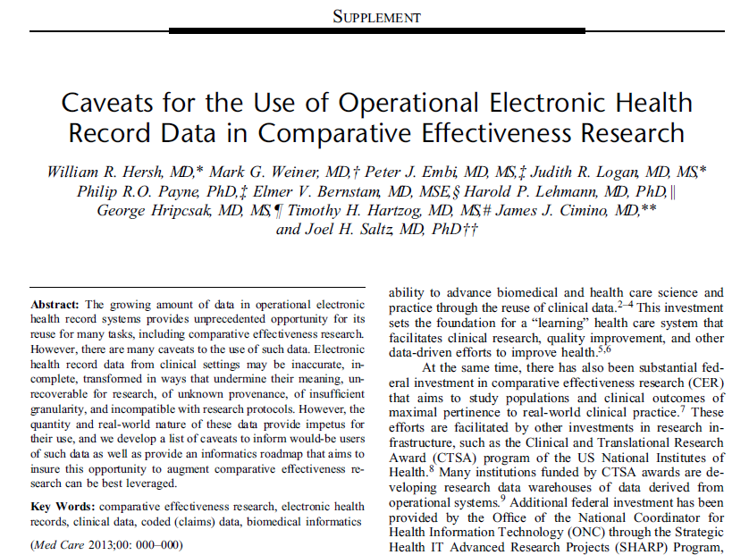
Finally published in Medical Care
Med Care 2013;51: S30–S37

Slide 35
Requirements for the appropriate application of Signal processing toward better healthcare
Understand what you can and cannot expect from observational data
Millions of lives and multiple years of overall data does not mean individuals are followed for a long enough time to assess all possible exposure/outcome associations
Big data does NOT always mean REPRESENTATIVE data
Results of Signal processing are SUPPOSED to provide a broad set of answers under different assumptions of the definition of exposed population, and the complex nature of drug exposure in the real world.

Slide 36
Requirements for the appropriate application of Signal processing toward better healthcare
Better accuracy than humans, or ability to augment human assessment is a great goal, but be mindful of what can be done with the improved knowledge that is gained
Love genomic-guided therapy
Hate imperfect risk prediction of diseases that have no adequate treatment
Beware impact of heterogeneity that exists within members of the same cluster
Be mindful of a tarnished gold standard in your classification analyses
Never forget the real people underlying the data you use and who are impacted by your findings

